Slide 1
Mobile Computing
Wireless Communication Systems

Slide 2
Satellite systems
Began after the Second World War
Offer global coverage
Without wiring costs for base stations
Almost independent of varying population densities.
Applications
Weather forecasting, Radio and TV broadcast satellites, Military satellites, Satellites for navigation.
Global telephone backbones, Connections for remote or developing areas, Global mobile communication

Slide 3
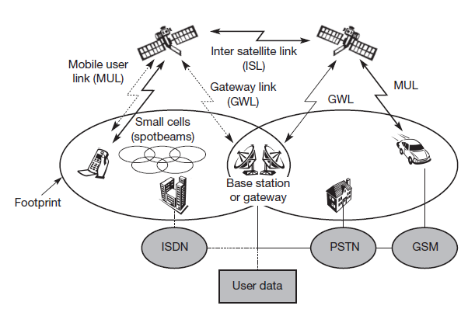
Typical satellite system for global mobile telecommunications

Slide 4
Contnd..
Footprint
Area of coverage on the earth with the beam from the satellite.
Create smaller cells using spot beams
Mobile user link (MUL)
Communication link with the satellite for mobile users
Gateway link (GWL)
Base station controlling the satellite and acting as gateway to other networks
Intersatellite links (ISL)
Communication with other sattelites
Vertical handoff & Horizontal handoff

Slide 5
Basics
Orbits can be circular or elliptical.
Satellites in circular orbits always keep the same distance to the earth’s surface
The attractive force Fg of the earth due to gravity = m·g·(R/r)²
The centrifugal force Fc trying to pull the satellite away equals m·r·ω²
m is the mass of the satellite;
R is the radius of earth with R = 6,370 km;
r is the distance of the satellite to the centre of the earth;
g is the acceleration of gravity with g = 9.81 m/s2;
and ω is the angular velocity with ω = 2·π·f, f is the frequency of the rotation.

Slide 6
Contnd..
To keep the satellite in a stable circular orbit
Fg = Fc
The distance r = (g·R²/(2·π·f)²)^{1/3}
Distance of a satellite to the earth’s surface depends on its rotation frequency.
when the satellite period equals 24 hours, distance is 35,786 km.
Geostationary satellite if it is additionally placed above the equator.

Slide 7
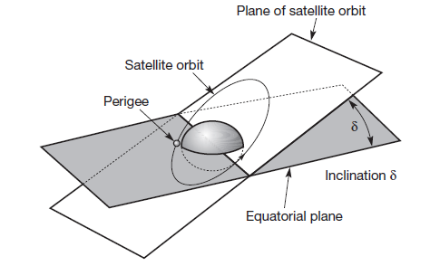
The inclination angle δ
The angle between the equatorial plane and the plane described by the satellite orbit.

Slide 8
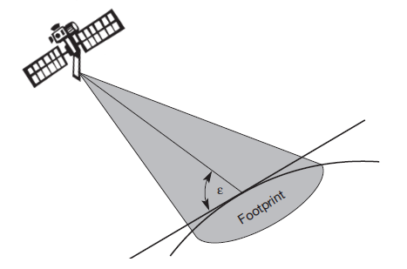
The elevation angle ε
The angle between the center of the satellite beam and the plane tangential to the earth’s surface.

Slide 9
Contnd..
Attenuation of the signal power depends on the distance between a receiver on earth and the satellite, satellite elevation and atmospheric conditions.
L = (4·π·r·f / c)²
Where f being the carrier frequency and c the speed of light.
The power of the received signal decreases with the square of the distance.
Directly influences the maximum data rates achievable
For mobile phones
10 kbit/s with a 2 GHz carrier for satellites in some 100 km distance.
10 bit/s are possible with geostationary satellites

Slide 10
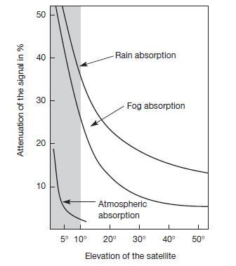
Contnd..
Attenuation due to atmospheric conditions
Depending on the elevation, the signal has to penetrate a smaller or larger percentage of the atmosphere.
Generally, an elevation less than 10 degrees is considered useless for communication.

Slide 11
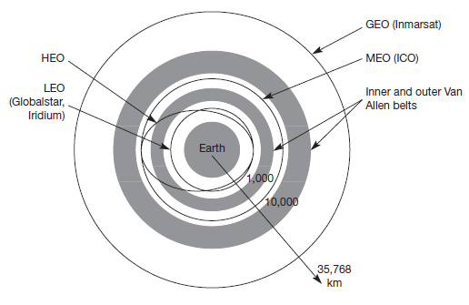
Types of Orbits

Slide 12
Types of Orbits
Geostationary (or geosynchronous) earth orbit (GEO)
Medium earth orbit (MEO)
Low earth orbit (LEO)
Highly elliptical orbit (HEO)

Slide 13
GEO
Resulting distance is 35,786 km
The orbit must have an inclination of 0 degrees.
Advantages
Three GEO satellites are enough for a complete coverage of almost any spot on earth.
Senders and receivers can use fixed antenna positions, no adjusting is needed.
Ideal for TV and radio broadcasting.
Lifetime for GEOs are rather high, at about 15 years.
GEOs do not need a handover due to the large footprint.
GEOs do not exhibit any Doppler shift
Since the relative movement is zero.

Slide 14
Disadvantages
Northern or southern regions of the earth have more problems receiving these satellites
Larger antennas are needed in this case.
Shading of the signals in cities
Due to high buildings and the low elevation further away from the equator limit transmission quality.
The transmit power needed is relatively high (some 10 W)
Causes problems for battery powered devices.
These satellites cannot be used for small mobile phones.
The biggest problem for voice and also data communication
The high latency of over 0.25 s one-way – many retransmission schemes which are known from fixed networks fail.
Either frequencies cannot be reused
Due to the large footprint,
The GEO satellite needs special antennas focusing on a smaller footprint.
Transferring a GEO into orbit is very expensive.

Slide 15
LEO
Circulate on a lower orbit
Periods are 95 to 120 minutes
200 - 1200 km above Earth's surface
Try to ensure a high elevation for every spot on earth to provide a high quality communication link.
Will be visible from the earth for around ten minutes.
Little LEOs with low bandwidth services (some 100 bit/s),
Big LEOs (some 1,000 bit/s)
Broadband LEOs with plans reaching into the Mbit/s range

Slide 16
Contnd..
Advantages
Provides bandwidth sufficient for voice communication
With omni-directional antennas using low transmit power in the range of 1W.
Delay for packets delivered via a LEO is relatively low (approx 10 ms).
LEOs allow for better frequency reuse
Smaller footprints of
LEOs can provide a much higher elevation in polar regions and so better global coverage.

Slide 17
Contnd..
Disadvantages
Need of many satellites for global coverage.
50–200 or even more.
High complexity of the whole satellite system.
Requires additional mechanisms for connection handoff.
The short time of visibility with a high elevation.
Short lifetime of about five to eight years
Due to atmospheric drag and radiation from the inner Van Allen belt.
A new satellite would be needed every two months.
Need for routing of data packets from satellite to satellite.
If a user wants to communicate around the world.

Slide 18
MEO
Positioned somewhere between LEOs and GEOs
1200 - 35790km above Earth's surface
Advantages
Using orbits around 10,000 km, the system only requires a dozen satellites for global coverage.
move more slowly relative to the earth’s rotation allowing a simpler system design
Can cover larger populations, so requiring fewer handovers.

Slide 19
Contnd..
Disadvantages
Delay increases to about 70–80 ms
Need higher transmit power and special antennas for smaller footprints

Slide 20
HEO
Moves much faster when it is close to Earth than when it is further away.
Apogee: Furthest from the Earth
Perigee: Closest to the Earth
Permanent coverage can be achieved by
Placing a number of satellites in the same orbit,
Equally spaced apart.
Provide high latitude and polar coverage
Disadvantage
The satellite position from a point on the Earth does not remain the same

